Slide 1
Memory Resource Management in VMware ESX Server

Slide 2
Paper highlights
Four novel mechanisms and policies for managing memory in the VMware ESX Server.
Ballooning shrinks when needed number of page frames allocated to a VM
Content-based page sharing eliminate redundancy
Idle memory tax achieves efficient memory utilization while maintaining performance isolation guarantees
Hot I/O page remapping reduce copying overhead

Slide 3
VMWare ESX
Virtual machine monitor
Not hosted
No underlying OS
Manages hardware directly
Significantly higher I/O performance
Runs existing OSes without modifications
IBM VM/370 designers could influence the design of the guest OSes

Slide 4
Hosted VMM
Non-Hosted VMM
Run on top of a host OS
Linux, Windows, …
Use guest OS for portable I/O device support
Translate guest OS attempts to read sectors from its virtual disk into read system calls to the host OS
Run on bare hardware
Translate guest OS attempts to read sectors from its virtual disk into actual accesses to the machine disk

Slide 5
Memory virtualization
Double mapping
Guest OS maps virtual addresses into its own fake physical addresses
VMM converts these addresses into machine addresses
Virtual addresses
(Fake) Physical addresses
Machine addresses

Slide 6
Paging data structures
One pmap for each VM mapping (fake) physical page numbers into machine page numbers
Special shadow pages contain direct virtual-to-machine page mappings
Kept consistent with contents of pmap
Provide direct translation from virtual addresses into machine addresses

Slide 7
Reclaiming memory space

Slide 8
Motivation
ESX server overbooks the machine memory
Gives to each VM the illusion of having affixed amount (maximize) of physical memory
When memory is scarce
Must have a way to reclaim space from VMs
Standard approach is to introduce another level of paging
Can expel fake physical pages from machine memory
Hard to decide which ones due to lack of information

Slide 9
Ballooning
ESX server introduces a balloon module into the guest OS
Small
Pretends to be a pseudo-device driver or a kernel service
No external interface with the guest OS
Private channel with VMM
Can take machine pages from guest OS by allocating pinned physical pages within the VM (inflating the balloon)
Can return machine pages from guest OS by deallocating these pages (deflating the balloon)

Slide 10
Ballooning

Slide 11
Main advantage
Guest OS still decides with virtual pages will be expelled from main memory
Uses the OS page replacement policy
Bases its decision on what it knows from process behavior

Slide 12
Memory protection
Guest OS cannot access machine pages within the balloon
It believes the space is occupied by a pseudo-device driver or a kernel service
For extra security
ESX Server annotates pmap entry of ballooned physical pages and deallocate the corresponding machine pages.
Any attempt by VM to access these pages will cause a fault
Rare event

Slide 13
Implementation
Balloon drivers for Linux, FreeBSD and Windows guest Oses
Poll the VMM server once per second to obtain a target balloon size
Limit their allocation rates adaptively

Slide 14
Ballooning performance
Grey: VM configured with 256 MB then ballooned
Black: VM configured with exact memory size

Slide 15
Limitations
Balloon driver can be
Uninstalled,
Explicitly disabled
Not available at boot time
Temporarily unable to reclaim memory quickly enough
Guest OS could impose limitations on balloon size

Slide 16
Demand paging
Only used when ballooning is impossible or insufficient
Reclaims machine pages by paging out to an ESX Server swap area
Guest OSes are not involved
Managed by ESX Server swap daemon
Uses a randomized page replacement policy
To prevent pathological interactions with guest OS memory management policy
Because it was expected to be fairly uncommon

Slide 17
Sharing memory

Slide 18
Sharing memory
Want to eliminate redundant copies of pages that are common to multiple VMs
When different VMs run instances of same guest OS
Sharing memory reduces memory footprint of VMs
Allow higher levels of overcommitment

Slide 19
Content-based page sharing
Cannot change
Guest Oses
Application program interfaces
ESX Server identifies pages copies by their contents
Transparent to guest Oses
Can identify more common pages
Problem is how to detect these common pages

Slide 20
A hashing approach
Page contents are hashed
Comparing page hashes is much faster
Do a full comparison of two pages iff a successful match is found
If two pages have identical contents
Mark one of them copy-on-write
Delete the other
Still remain to decide when to scan
Controlled by a high-level policy

Slide 21
Hint pages
Pages for which a match could not be found
But we still have a valid hash
Marked hint until their hash is found to have changed

Slide 22
Implementation
Each encoded frame occupies 16 byte
A shared frame contains
A hash value
The machine page number for the shared page
A reference count
A link for chaining
A hint frame has a truncated hash value to leave place for a VM number and a PPN

Slide 23
Implementation
White pages are shared
Dark grey pages are just hints
Candidates

Slide 24
More details
16-bit reference counter
Overflow table for larger count values
Say number of zero-filled pages
64-bit hash function
Very few false positives
Can exclude them from sharing

Slide 25
When to scan
Randomly
System parameter controls maximum per-VM and overall scanning rate
Always attempt to share a page before swapping it out

Slide 26
Performance
Becomes better as number of VMs increases
For large numbers of VMs
Sharing approaches 67%
Can reclaim nearly 60% of memory

Slide 27
Real world data

Slide 28
Competing for memory

Slide 29
Shares v. Working Sets
Traditional memory allocation aims at maximizing system throughput
Each process should have its working set of pages
Not true for VMM
Must take into account various QoS requirements for each VM
ESX Server uses a share-based algorithm

Slide 30
Share-based allocation
Each VM gets a finite number of shares
Kind of tickets
Control amount of system resources VM can use
When a client demands more space
Reclaim memory from VM with fewest shares per allocated page
Share-per-page ratio can be viewed as a price

Slide 31
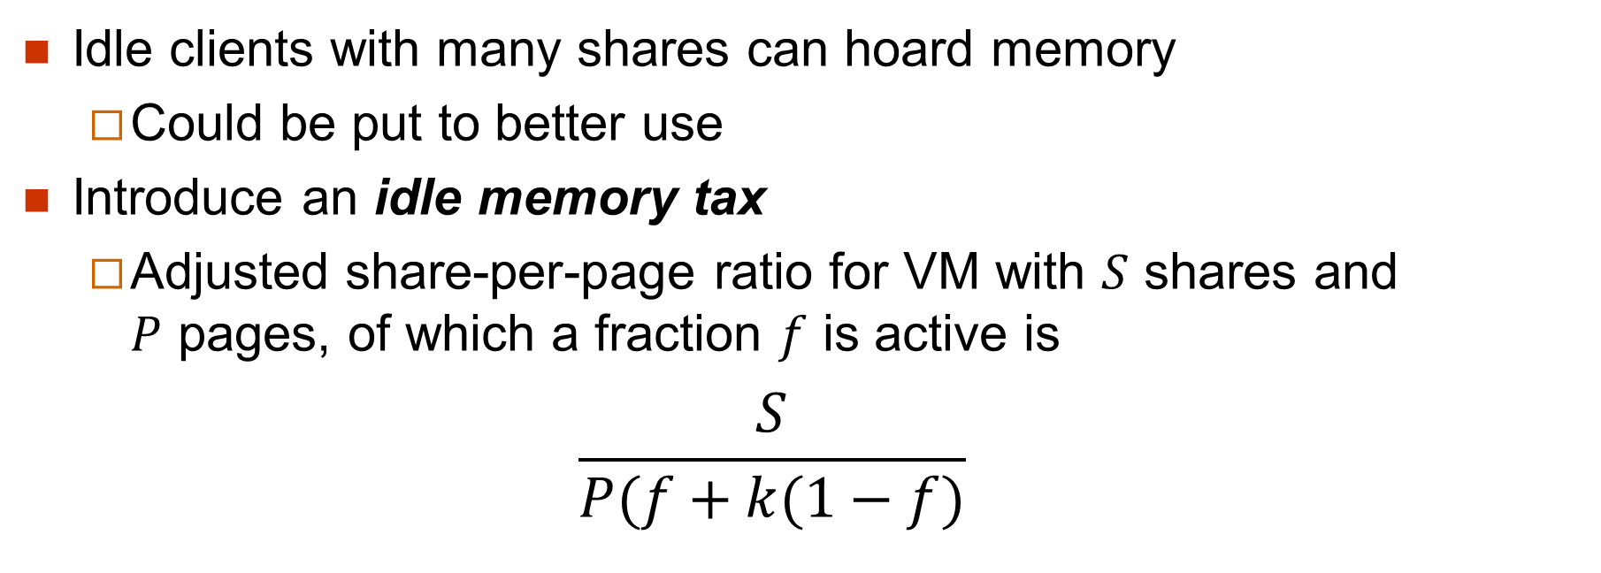
Reclaiming idle memory
Idle clients with many shares can hoard memory
Could be put to better use
Introduce an idle memory tax
Adjusted share-per-page ratio for VM with $S$ shares and $P$ pages, of which a fraction $f$ is active is
$$\frac{S}{P(f+k(1−f)}$$

Slide 32
Measuring idle memory (I)
Through statistical sampling
Sampling period is defined in units of VM execution time
Select small number of random pages
Invalidate any cached mapping for all sampled pages
Intercept next guest access
Default sampling rate is 100 pages every 100 seconds

Slide 33
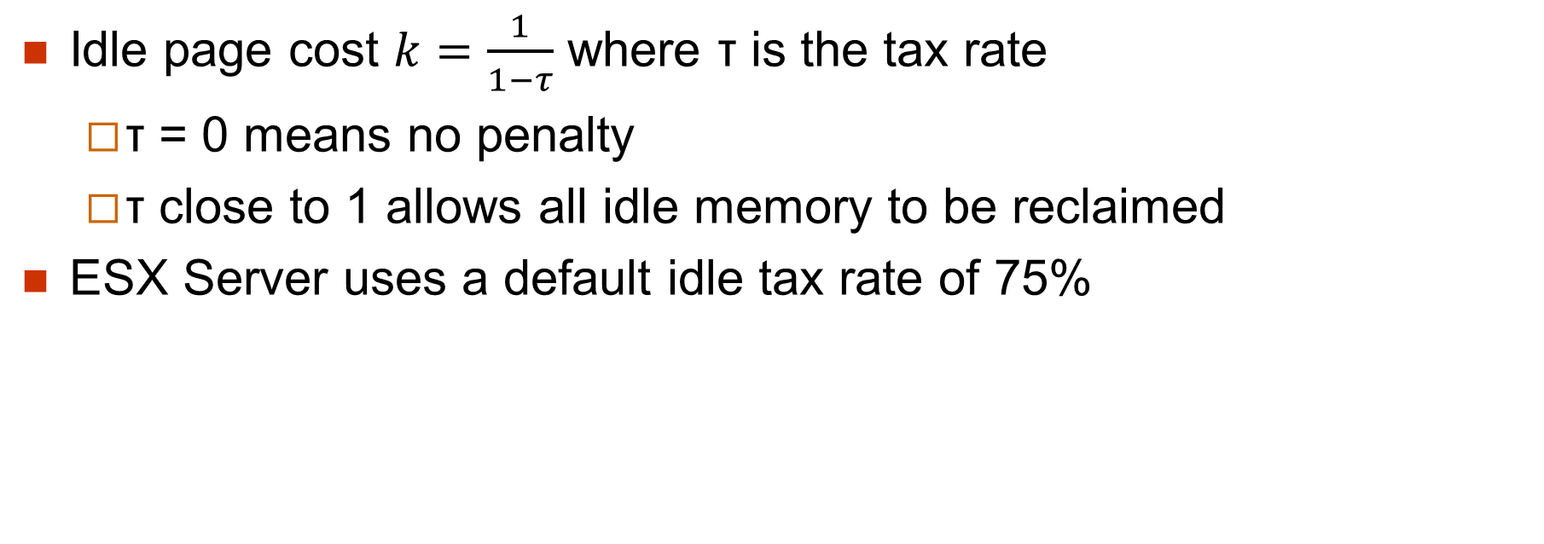
The tax rate
Idle page cost $k=\frac{1}{1−τ}$ where τ is the tax rate
τ = 0 means no penalty
τ close to 1 allows all idle memory to be reclaimed
ESX Server uses a default idle tax rate of 75%

Slide 34
Measuring idle memory (I)
Through statistical sampling
Sampling period is defined in units of VM execution time
Select small number of random pages
Invalidate any cached mapping for all sampled pages
Intercept next guest access
Default sampling rate is 100 pages every 30 seconds

Slide 35
Measuring idle memory (II)
Maintain three moving averages of fraction of memory f that is actively accessed
Slow moving
Fast moving
Version incorporating counts from current sampling period
Use highest estimate of f

Slide 36
Benefits
With idle tax:
Allocations reflect usage
Without idle tax:
Equal allocations
Two processes are promised 256MB of RAM
Due to overbooking, can only get less

Slide 37
I/O page remapping

Slide 38
I/O page remapping (I)
Specific to 32-bit processors with extension allowing them to access 64 GB of RAM using extended 36-bit addresses
Caused problems with DMA that could only address the lowest 4GB of memory
Solution was
Track “hot” pages in high memory with a lot of I/O traffic
Remap them in low memory
Can increase demand for low-memory pages

Slide 39
I/O page remapping (I)
Solution addressed a limitation of 32-bit address spaces
Less an issue today with 64-bit address spaces
Will probably take a long time before the problem reappear

Slide 40
Higher-level dynamic reallocation policy

Slide 41
Summary
From the paper
A new ballooning technique reclaims memory from a VM by implicitly causing the guest OS to invoke its own memory management routines.
An idle memory tax was introduced to solve an open problem in share-based management of space-shared resources, enabling both performance isolation and efficient memory utilization.
Idleness is measured via a statistical working set estimator.
Content-based transparent page sharing exploits sharing opportunities within and between VMs without any guest OS involvement. …

